Slide 1
Experiments or Lab Programs:
Implement and demonstrate the FIND-S algorithm for finding the most specific hypothesis based on a given set of training data samples. Read the training data from a .CSV file.
For a given set of training data examples stored in a .CSV file, implement and demonstrate the Candidate Elimination algorithm to output a description of the set of all hypotheses consistent with the training examples.
Write a program to demonstrate the working of the decision tree based ID3 algorithm. Use an appropriate data set for building the decision tree and apply this knowledge to classify a new sample.
Write a program to implement the naïve Bayesian classifier for a sample training data set stored as a .CSV file. Compute the accuracy of the classifier, considering few test data sets.
Write a program to implement k-Nearest Neighbour algorithm to classify the iris data set. Print both correct and wrong predictions.
Build an Artificial Neural Network by implementing the Backpropagation algorithm and test the same using appropriate data sets.
Write a program to demonstrate Regression analysis with residual plots on a given data set.
Write a program to compute summary statistics such as mean, median, mode, standard deviation and variance of the given different types of data.
Write a program to implement k-Means clustering algorithm to cluster the set of data stored in .CSV file.

Slide 2
Program-1: Implement and demonstrate the FIND-S algorithm for finding the most specific hypothesis based on a given set of training data samples. Read the training data from a .CSV file.

Slide 3
FIND-S algorithm: (Find-Yes)
FIND-S (Find-Specific) is a simple concept learning algorithm used in Machine Learning. It finds the most specific hypothesis that fits all the positive training examples in the dataset.

Slide 4
✅ What is Concept Learning?
Concept Learning is a type of supervised learning where the goal is to learn a rule or function (called a concept) that classifies examples into positive (Yes) or negative (No) classes.
For example:
Suppose you're trying to learn the concept of "EnjoySport".
You are given a dataset with different weather conditions.
Each row in the data says whether the sport was enjoyed (Yes) or not (No) under those conditions.
Your job is to learn what combination of conditions leads to "EnjoySport = Yes" — this is the "concept".

Slide 5
✅ Hypothesis in Machine Learning? (Theory or Thesis)
A hypothesis is a candidate rule or guess that might describe the concept you're trying to learn.
A hypothesis is a guess or rule that helps predict the output (like Yes/No) given an input.
For example:
Hypothesis= ['Sunny', 'Warm', '?', 'Strong', '?', ‘?’]
This hypothesis says:
"A person will enjoy sport if it is Sunny and Warm and Wind is Strong (rest can be anything)."
This means:
"If the sky is Sunny, and the temperature is Warm, and the wind is Strong — regardless of other factors — then we can say YES to 'EnjoySport'".

Slide 6
🎯 Purpose of FIND-S
Learn from positive examples only (i.e., where the target output is Yes).
Ignore negative examples (No).
Construct the most specific hypothesis that explains all the positive instances.

Slide 7
🧠 How FIND-S Works (Step-by-Step)
Let’s say each example has n attributes, and the goal is to find a hypothesis ‘h’ that is as specific as possible, but consistent with all positive examples.
Step 1: Initialize
Start with the most specific hypothesis possible.
Example: ['∅', '∅', '∅'] or simply the first positive example. (Means the output is Positive)
Step 2: For each training example:
If the example is positive:
Compare it with the current hypothesis.
If any attribute in the hypothesis is different from the current example:
Replace that attribute with ? (which means "any value").
If the example is negative, ignore it.
Step 3: Continue until all examples are processed.
Step 4: The resulting hypothesis is the most specific generalization consistent with the positive examples.

Slide 8
Example Dataset:
Let’s say we’re learning the concept of EnjoySport. Our training dataset looks like this:
Sky | Temp | Humidity | Wind | Water | Forecast | EnjoySport
Sunny | Warm | Normal | Strong | Warm | Same | Yes
Sunny | Warm | High | Strong | Warm | Same | Yes
Rainy | Cold | High | Strong | Warm | Change | No
Sunny | Warm | High | Strong | Cool | Change | Yes

Slide 9
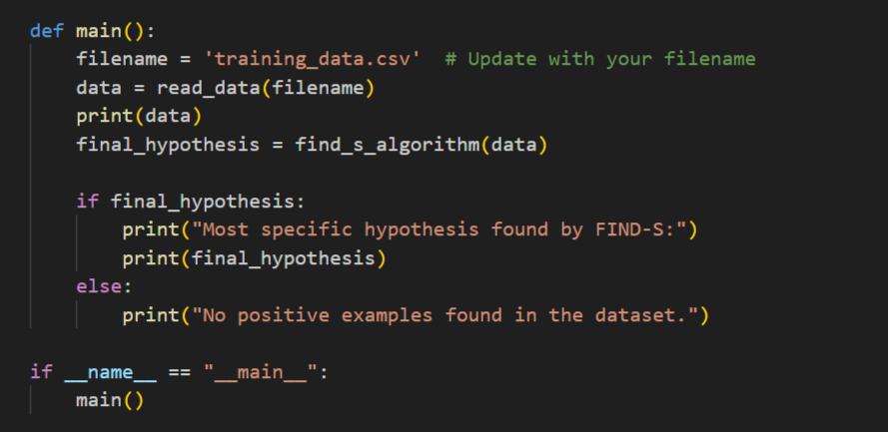

Slide 10
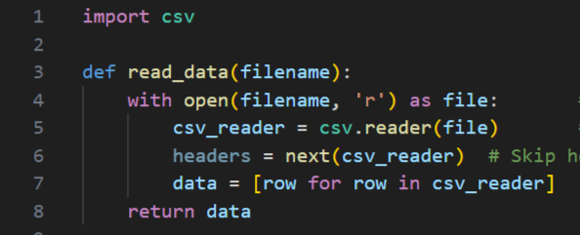

Slide 11
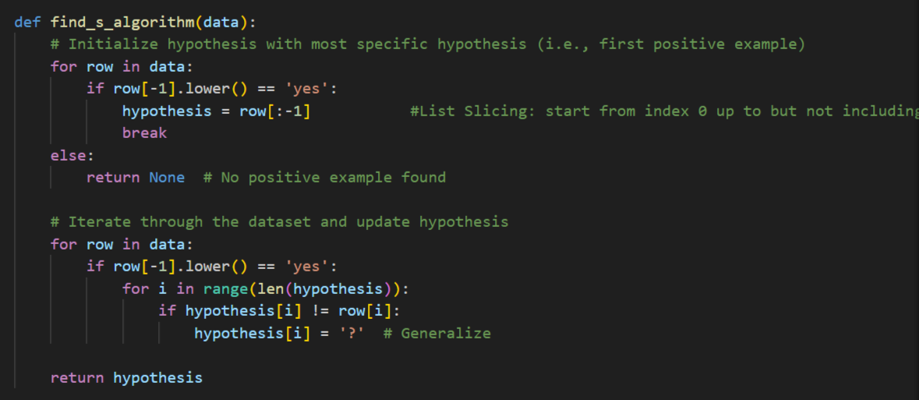

Slide 12
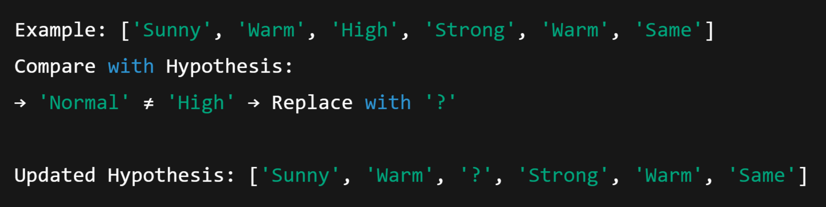
🚀 Step-by-Step Working of FIND-S on Above Data
Start with the first positive example:
Process second positive example:

Slide 13
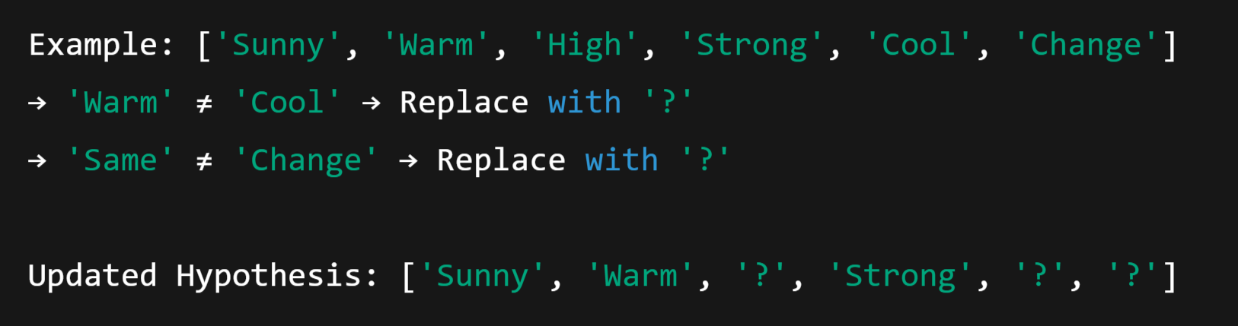
3. Skip third example (it's negative)
4. Process fourth positive example:

Slide 14

🧾 Final Hypothesis:
This means:
Sky must be Sunny
Temp must be Warm
Wind must be Strong
All other values can be anything

Slide 15
Program-2: For a given set of training data examples stored in a .CSV file, implement and demonstrate the Candidate Elimination algorithm to output a description of the set of all hypotheses consistent with the training examples.

Slide 16
🧠 What is the Candidate Elimination Algorithm?
The Candidate Elimination Algorithm is a supervised learning algorithm in Machine Learning that:
Learns the target concept from training data
Maintains a version space:
S: The most specific hypotheses (specific boundary)
G: The most general hypotheses (general boundary)
The version space is the set of all hypotheses consistent with the training data seen so far. The goal is to narrow this space as we process more examples.

Slide 17
📌 1. What is a Target Concept?
In machine learning, a target concept is the thing we are trying to learn or classify.
In our example
The column EnjoySport is the target concept. We are trying to learn a rule (hypothesis) that tells us under what conditions a person enjoys sport.
Sky | Temp | Humidity | Wind | Water | Forecast | EnjoySport
Sunny | Warm | Normal | Strong | Warm | Same | Yes

Slide 18
What is Version Space?
The version space is the set of all possible hypotheses that are consistent with the training examples seen so far.
It is represented as:
A boundary of S: Specific hypotheses
A boundary of G: General hypotheses

Slide 19
What is S (Specific Boundary)?
S stands for the most specific hypothesis that fits all positive examples.
It starts as the most specific possible: ['∅', '∅', ..., '∅'] (rejects everything).
It gets generalized when we see positive examples.
Example:
After seeing positive examples:
This means: "Enjoy sport only under these specific conditions."

Slide 20
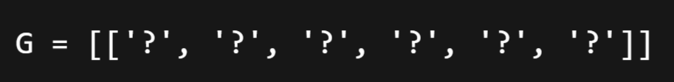
📌 5. What is G (General Boundary)?
G is the set of most general hypotheses that do not contradict any negative example.
It starts as:
(Accepts everything)
It gets specialized (made stricter) when we see negative examples.

Slide 21
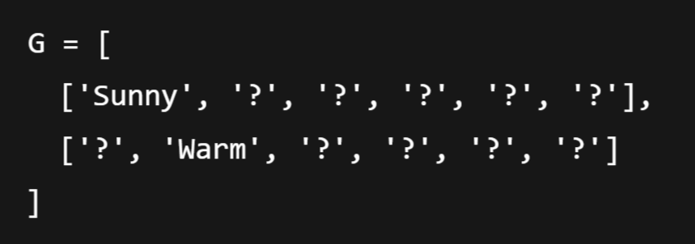
Example:
After processing some negative examples:
This means: "Do NOT enjoy sport when it’s not Sunny or not Warm."

Slide 22
📌 Key Idea
We maintain two boundaries:
S: Starts from the most specific hypothesis — '∅' (doesn’t accept anything)
G: Starts from the most general hypothesis — '?' for all attributes (accepts everything)
With each training example:
If it's positive:
Generalize S minimally to include the example.
Remove G hypotheses that do not include the example.
If it's negative:
Specialize G minimally to exclude the example.
Remove S hypotheses that include the negative example.

Slide 23
🧾 Example
Let’s say we’re learning the concept of EnjoySport. Our training dataset looks like this:
Sky | Temp | Humidity | Wind | Water | Forecast | EnjoySport
Sunny | Warm | Normal | Strong | Warm | Same | Yes
Sunny | Warm | High | Strong | Warm | Same | Yes
Rainy | Cold | High | Strong | Warm | Change | No
Sunny | Warm | High | Strong | Cool | Change | Yes

Slide 24
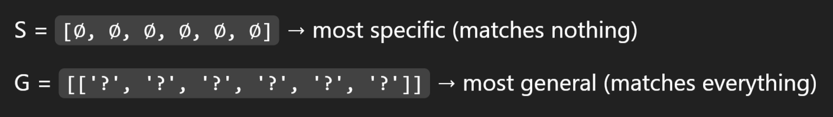
Step-by-step Execution
Initial state:
After Example 1: Positive:
S becomes this example:
G remains unchanged.

Slide 25
3. After Example 2: Positive:
S is generalized: "Normal" ≠ "High" → replace with ‘?’
G remains the same.

Slide 26
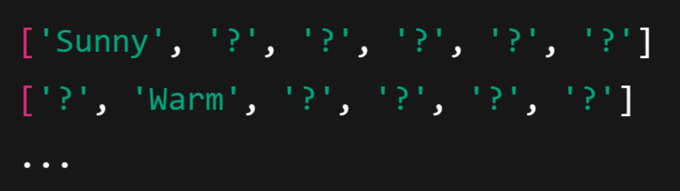
4. After Example 3: Negative:
This negative example is covered by G and must be excluded.
Specialize G (i.e., make it more specific to exclude this row but still include S):
We generate specific hypotheses like:
All combinations that do not match the negative example but are consistent with S.

Slide 27
5. After Example 4: Positive:
S is generalized again:
Water: "Warm" ≠ "Cool" → '?'
Forecast: "Same" ≠ "Change" → ‘?’
G: remove hypotheses that don't cover this positive example.

Slide 28
✅ Final Hypotheses
S = ['Sunny', 'Warm', '?', 'Strong', '?', '?']
G = a set of hypotheses that include all positive and exclude all negative examples

Slide 29
5. Write a program to implement k-Nearest Neighbour algorithm to classify the iris data set. Print both correct and wrong predictions.

Slide 30
🌸 What is the Iris Dataset?
The Iris dataset is one of the most famous datasets in machine learning and statistics. It was introduced by the British biologist Ronald A. Fisher in 1936 and is often used to demonstrate classification algorithms.
🧠 What Does It Contain?
The dataset contains 150 samples of iris flowers, divided into 3 species (classes):
Species (Class) | Label (Target)
Iris Setosa | 0
Iris Versicolor | 1
Iris Virginica | 2

Slide 31
Each flower is described by 4 numeric features:
Feature | Description | Unit
Sepal length | Length of the sepal (outer leaf) | cm
Sepal width | Width of the sepal | cm
Petal length | Length of the petal (inner leaf) | cm
Petal width | Width of the petal | cm

Slide 32
📊 Sample Data:
Note: Each row represents one flower.
Sepal Length | Sepal Width | Petal Length | Petal Width | Species
5.1 | 3.5 | 1.4 | 0.2 | Iris-setosa
7.0 | 3.2 | 4.7 | 1.4 | Iris-versicolor
6.3 | 3.3 | 6.0 | 2.5 | Iris-virginica

Slide 33
🧪 Why Is It So Popular?
Small size – only 150 rows.
Clean and well-balanced – 50 samples per class.
Simple structure – only 4 input features.
Great for learning classification, visualization, and data processing techniques.

Slide 34
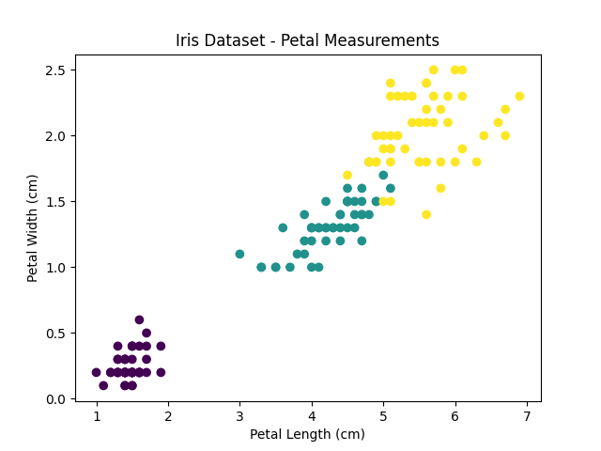
📈 Visualization:
The below visualization shows how well classes are separated in iris dataset:

Slide 35
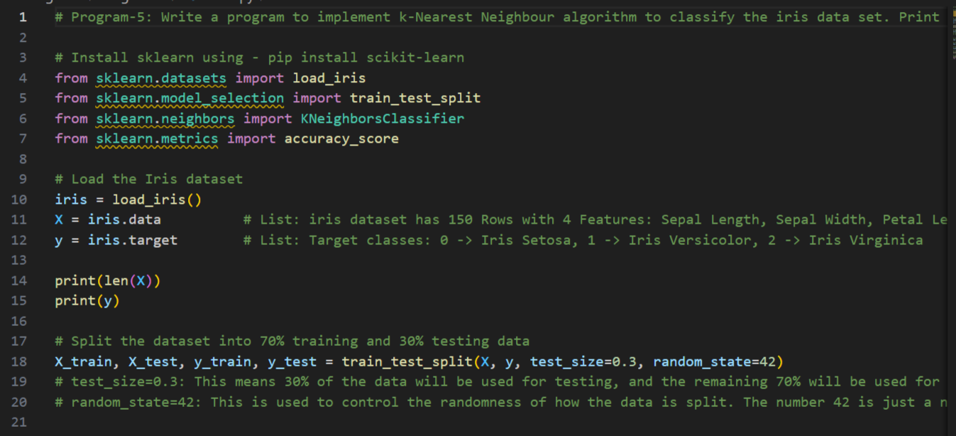

Slide 36
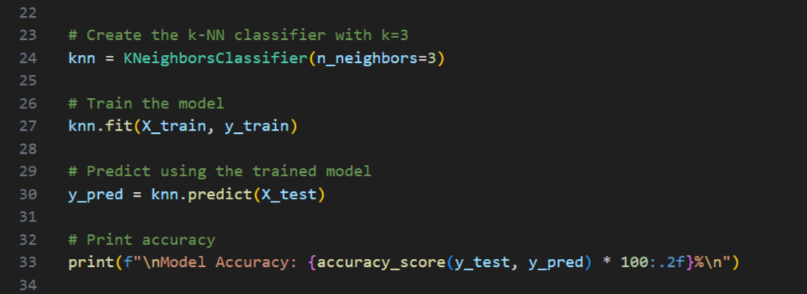

Slide 37
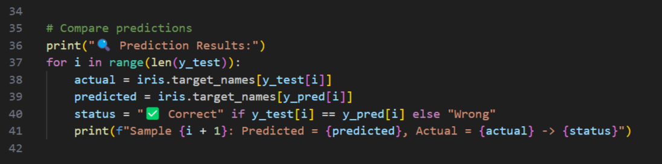

Slide 38
3. Write a program to demonstrate the working of the decision tree based ID3 algorithm. Use an appropriate data set for building the decision tree and apply this knowledge to classify a new sample.

Slide 39
🧠 What is ID3?
ID3 (Iterative Dichotomiser 3) is a popular decision tree algorithm used in machine learning for classification tasks.
Dichotomiser means :to divide into two parts, classes, or groups
🔍 Core Idea of ID3
ID3 builds a decision tree by selecting the attribute that gives the maximum information gain at each node.
It uses:
Entropy → Measures the impurity (or disorder) in a dataset
Information Gain → How much entropy is reduced by splitting on an attribute
Note: Impurity means how mixed or disordered a group of data is with respect to its target labels (like "Yes" or "No").

Slide 40
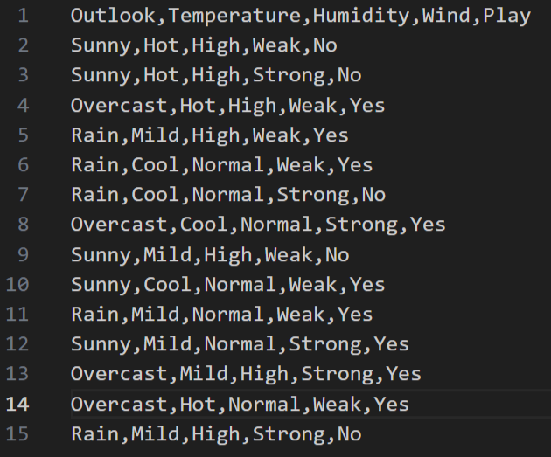

Slide 41
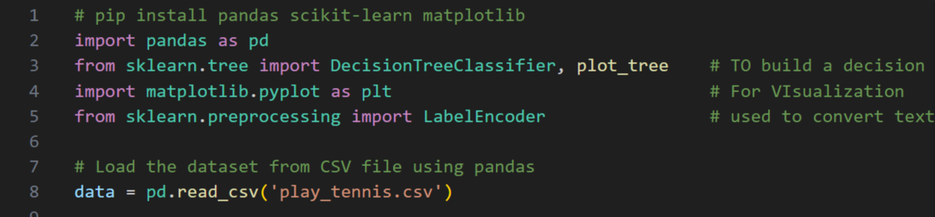

Slide 42
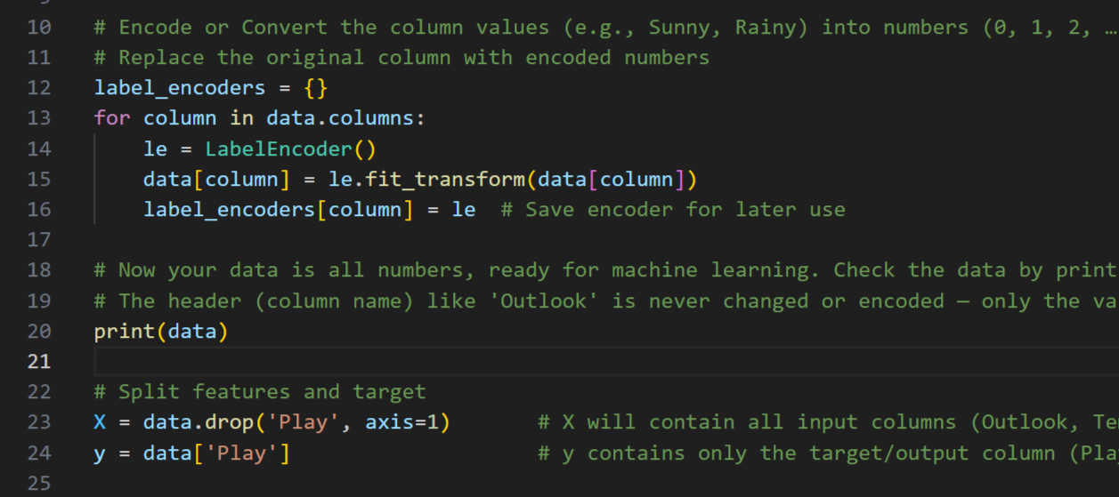

Slide 43
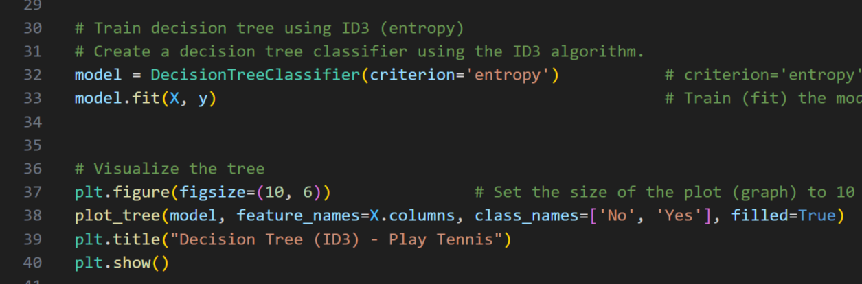

Slide 44
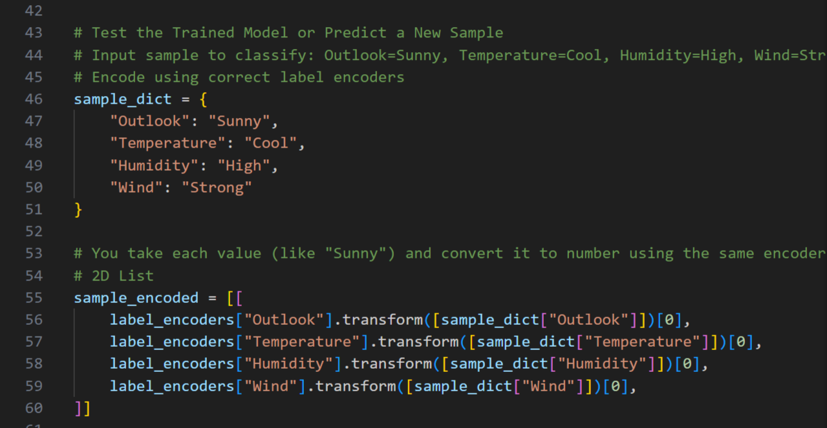

Slide 45
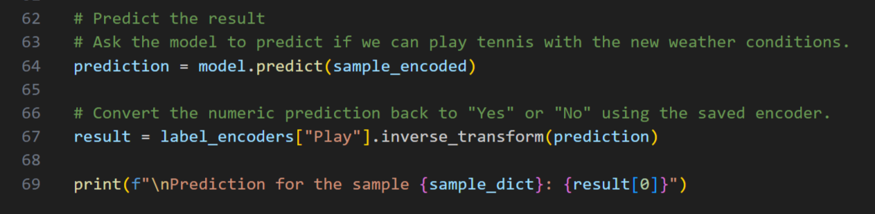

Slide 47
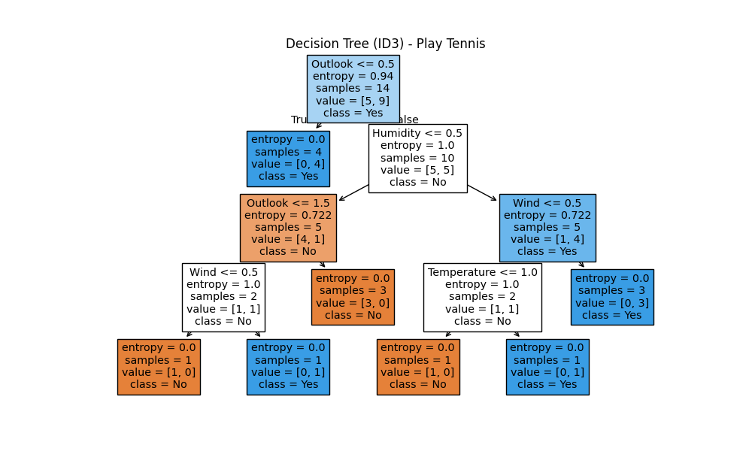

Slide 48
📘 How to Read the Tree:
Each box in the tree is a decision node or leaf. It contains:
A condition to test (e.g., Outlook <= 0.5) -> It tells Should I go left or right? Like Conditional Statement.
Entropy → how impure (Mixed values) this node is (0 means pure)
Samples → how many records reached this node
Value = [No, Yes] → count of class labels at this node
Class → predicted class at this node (No or Yes)

Slide 49
4. Write a program to implement the naïve Bayesian classifier for a sample training data set stored as a .CSV file. Compute the accuracy of the classifier, considering few test data sets.

Slide 50
Naive Bayes classifier:
The Naive Bayes classifier is a simple yet powerful probabilistic classifier based on Bayes' theorem. So the base of Naive Bayes classifier is Bayes' theorem.
Consider the Following Example:
Let’s say we have a Data Set with Features {x1, x2, x3, …… , xn} and the output {y}. Now the Task is to Classify the given data which is y by making use of the Features. For Navie Bayes Classifier we have to follow the Bayes Theorem, So according to the Bayes Theorem Formula we have to simplify our Problem.
Here, P(x1, x2, x3, ……, xn) is common for all the classes or records in the data set. So we can ignore it
Where ∝ denotes proportionality.
https://www.youtube.com/watch?v=jS1CKhALUBQ

Slide 51
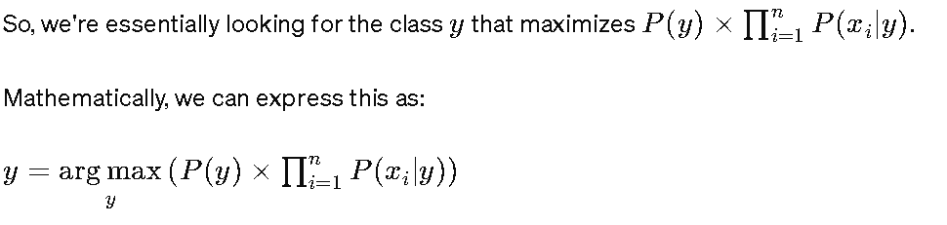
This equation implies that it is used to find the value of y that maximizes the expression In RHS. In other words, it returns the class label y that has the highest probability given the input features x1​,x2​,x3​,…,xn​.
For Example: Let say we have Binary Classifiier for Spam or Not Spam if we are getting the Probability = 0.7 for the Mail is Spam and 0.3 that the mail is Not Spam then we have to consider the maximum among these that is 0.7 which means the mail is Spam.

Slide 52
Steps in Naives Bayes Classifier:
The term "naive" in Naive Bayes classifier refers to the simplifying assumption made by the model regarding the independence of features. Specifically, it assumes that all features are conditionally independent given the class label. So all features of the dataset are equally important and independent, this is called Naive Bayes classifier
Naive Bayes classifier calculates the probability of an event in the following steps:
Step 1: Calculate the prior probability for given class labels
Step 2: Find Likelihood probability with each attribute for each class
Step 3: Put these value in Bayes Formula and calculate posterior probability.
Step 4: See which class has a higher probability, given the input belongs to the higher probability class.

Slide 53
Suppose we have a dataset with two classes, "spam" (denoted as y = spam) and "not spam" (denoted as y=not spam), and two features, x1​ and x2​.
We want to classify a new email with the following features:
x1​=buy
x2​=discount
Let's assume we have already calculated the following probabilities from our training dataset:
1. Prior probabilities:
P(spam)=0.4 // Consider it as 40% out of 100%
P(not spam)=0.6 // Consider it as 60%
2. Likelihoods:
P(buy∣spam)=0.8
P(discount∣spam)=0.6
P(buy∣not spam)=0.3
P(discount∣not spam)=0.5
Now, let's plug these values into the Naive Bayes classifier equation:

Slide 54
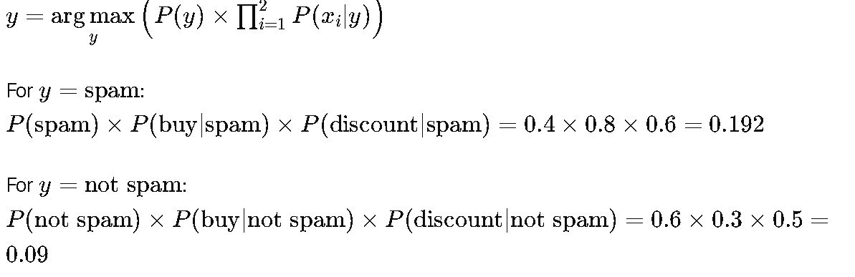
Comparing the two values, we see that y=spam gives the higher result.
Therefore, according to the Naive Bayes classifier, the predicted class for the given features "buy" and "discount" is "spam".

Slide 55
Example:
Suppose we have a dataset of emails labeled as either "spam" or "not spam" and each email is represented as a bag-of-words (i.e., a vector indicating the presence or absence of certain words). Here's a simplified version of the dataset:
Email | Label
"Get free money now" | spam
"Need a loan? Apply today" | spam
"Meeting for lunch today?" | not spam
"Get a discount on your next purchase" | spam
"Schedule for meeting tomorrow" | not spam
"Please review the attached document" | not spam

Slide 56
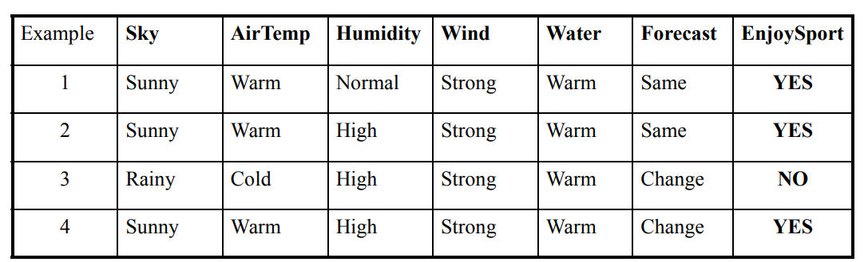
Example:
With relation to our example, this concept can be understood as:
We assume that no pair of features are dependent. For example, the Airtemp being ‘Hot’ has nothing to do with the humidity or the Sky being ‘Rainy’ has no effect on the winds. Hence, the features are assumed to be independent.
Secondly, each feature is given the same weight(or importance). For example, knowing only temperature and humidity alone can’t predict the outcome accurately. None of the attributes is irrelevant and assumed to be contributing equally to the outcome.

Slide 57
Naive Bayes classifier is a primary probabilistic classifier based on a view of applying Bayes’ theorem (from Bayesian inference with strong naive) independence assumptions. The prior probabilities in Bayes’ theorem that are changed with the help of newly available information are classified as posterior probabilities. A key benefit of the naive Bayes classifier is that it requires only a little bit of training information (data) to gauge the parameters (mean and differences of the variables) essential for the classification (arrangement). In the Naive Bayes classifier, independent variables are always assumed, and only the changes (variances) of the factors/variables for each class should be determined and not the whole covariance matrix. Because of the rather naive assumption that all features of the dataset are equally important and independent, this is called Naive Bayes classifier. Naive Bayes classifiers are direct linear classifiers that are known for being the straightforward, yet extremely proficient result. The modified version of Naive Bayes classifier originates from the assumption that information collection (data set) is commonly autonomous (mutually independent). In most of the practical scenarios, the ‘independence’ assumption is regularly violated.

Slide 58
7. Write a program to demonstrate Regression analysis with residual plots on a given data set.
Linear Regression: Y = mX + c

Slide 59
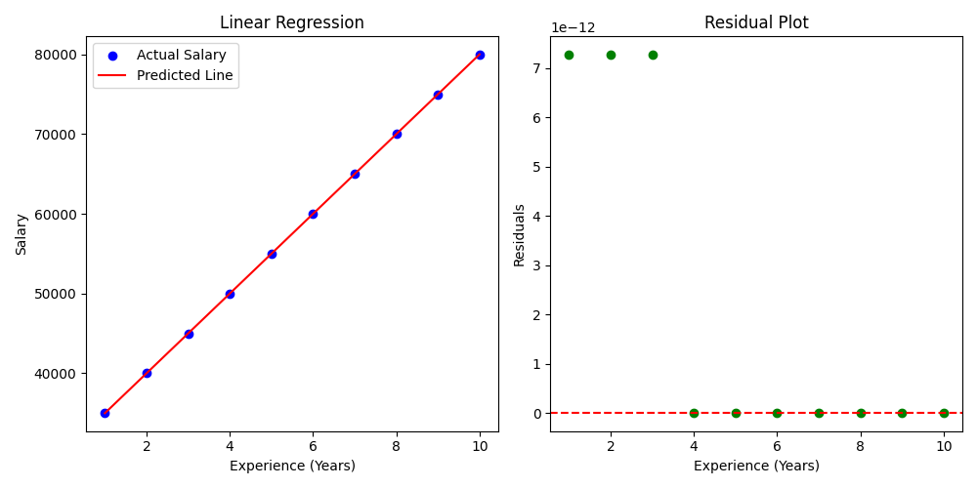

Slide 60
📈 Your Residual Plot (Right Side Graph)
🔹 X-axis: Experience (Years)
This is the same input variable as the main graph.
🔹 Y-axis: Residuals
This shows how far the predicted value was from the actual salary.
How to Interpret the Graph
Red Dashed Line at 0
This is the perfect prediction line.
If a green dot is on this line → prediction was perfect
If above the line → predicted salary was too low
If below the line → predicted salary was too high
2. 🟢 Green Dots
Each green dot is a data point (experience) showing how much the model was off:
Residual = 0 → Perfect prediction
Small residual → Good prediction
Big residual → Bad prediction

